Slide 1

Neuroscience
26 December2010-Neuroscience- Kareem Soliman
Kareem Soliman
Bibliotheca Alexandrina
2010, December

Slide 2
Outline
Introduction to neuroscience
NLP & Neuroscience, what is the difference?
Imagining techniques latest advancements
Latest advances in neuroscience
Karl Popper and education system
Summary

Slide 3
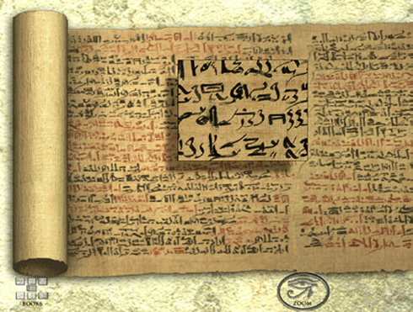

Egypt & Neuroscience

Slide 4
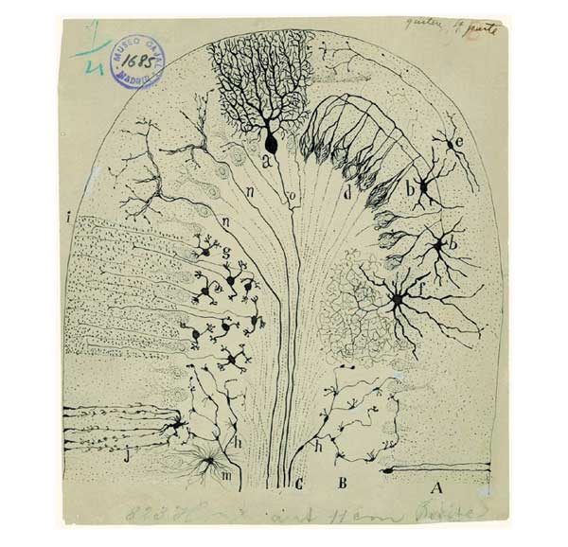
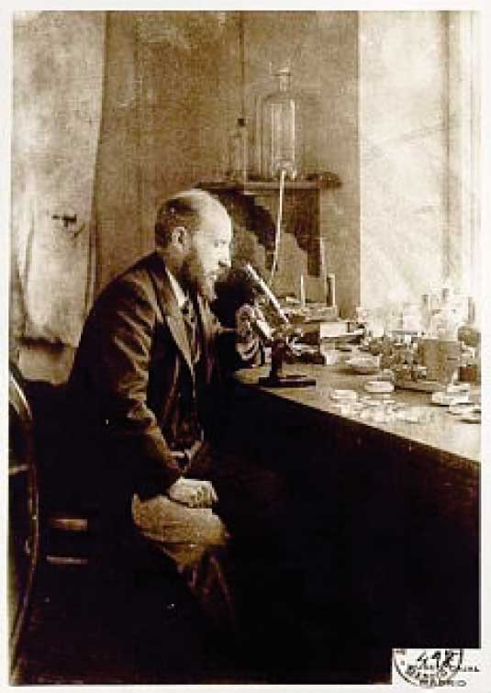
Santiago Ramón y Cajal
(1852-1934)

Slide 5
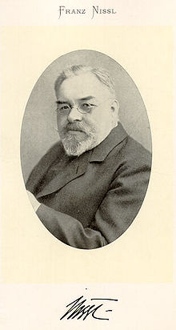
Franz Nissl
(1860-1919)

Slide 6
Nissl dye
Basophilic dye

Slide 7
How neuroscientists map the brain?
Case studies

Slide 8
Brain Machine

Slide 9
Action Potential (AP)

Slide 10
Input to output

Slide 11
Transistors vs. Neurons

Slide 12
Hodgkin-Huxley model

Slide 13
Selective permeability

Slide 14
Resting membrane potential

Slide 15
New models

